Slide 1
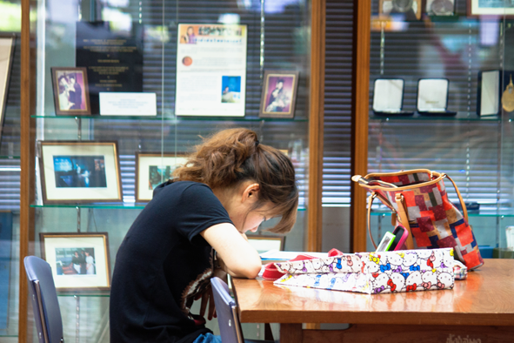
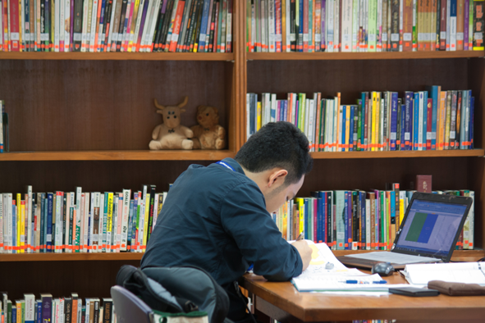
Orientation for New Graduate Students 2012
Welcome to
STANG MONGKOLSUK LIBRARY and Information Division

Slide 2
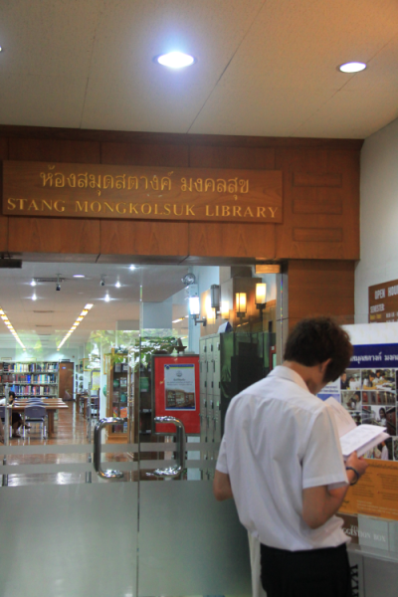
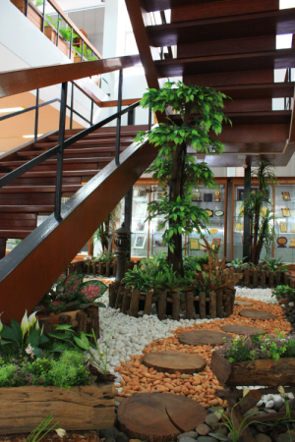
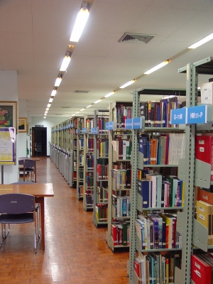
Where is Stang library ? Physics (P) Building - Floor 2-3
Established in 1968,
this library named in the honor of
the first dean and founder of the faculty, Professor Dr. Stang Mongkolsuk

Slide 3
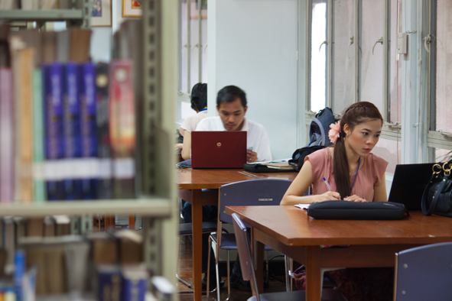
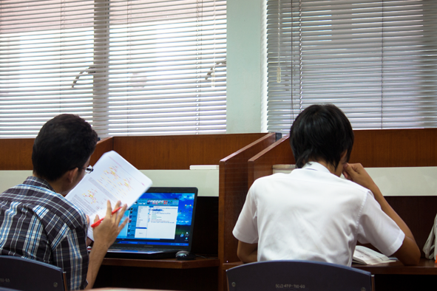
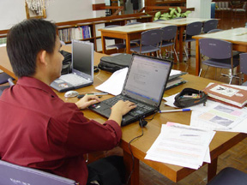
Opening Hours :
Mon.-Fri. 8:00 am - 7:30 pm
Sat. 8:30 am - 4:30 pm
Sun. & National Holidays - closed

Slide 4
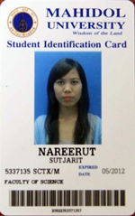
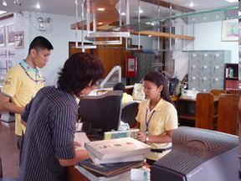
Use your “Student ID card” as “Mahidol library card” to
borrow books from
24 Mahidol libraries.
Type of Material | Loan Period | Items | Overdue Fine / Day
General Books | 15 days | 15 | 5 Baht
Reserve Books | 2 days |  | 30 Baht
Journals | 3 days |  | 5 Baht
Theses | 3 days |  | 30 Baht
Theses (Reserve) | 1 day |  | 30 Baht

Slide 5
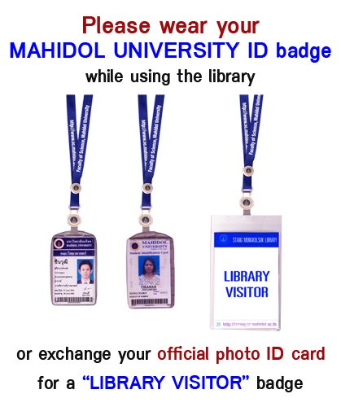
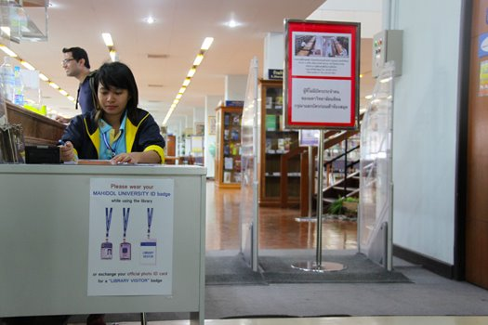

Slide 6
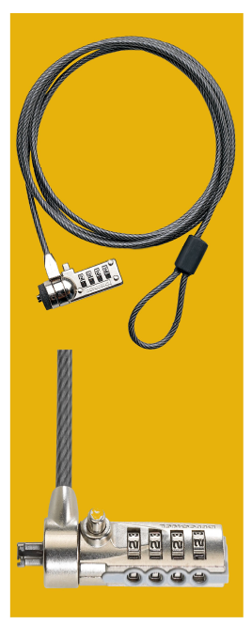
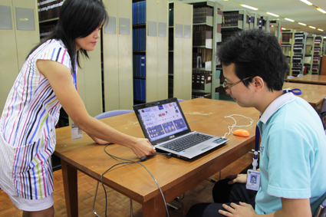
Laptop Lock Cable available
Take care of your belongings. The Library staff will not be responsible for any loss or damage of your personal belongings left unattended in the library

Slide 7
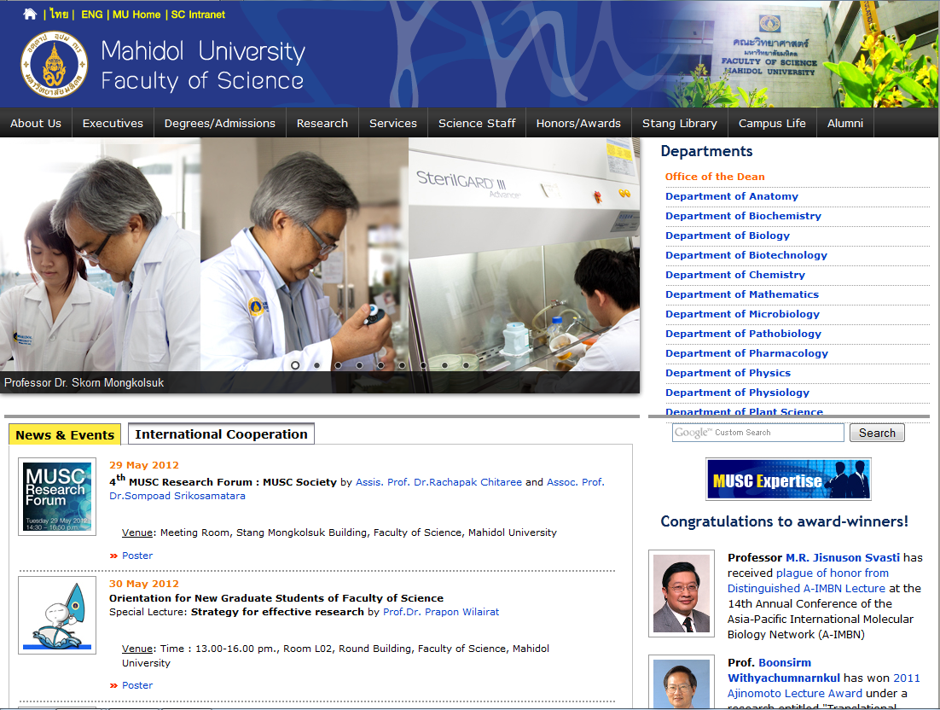
MUSC Website : www.sc.mahidol.ac.th

Slide 8
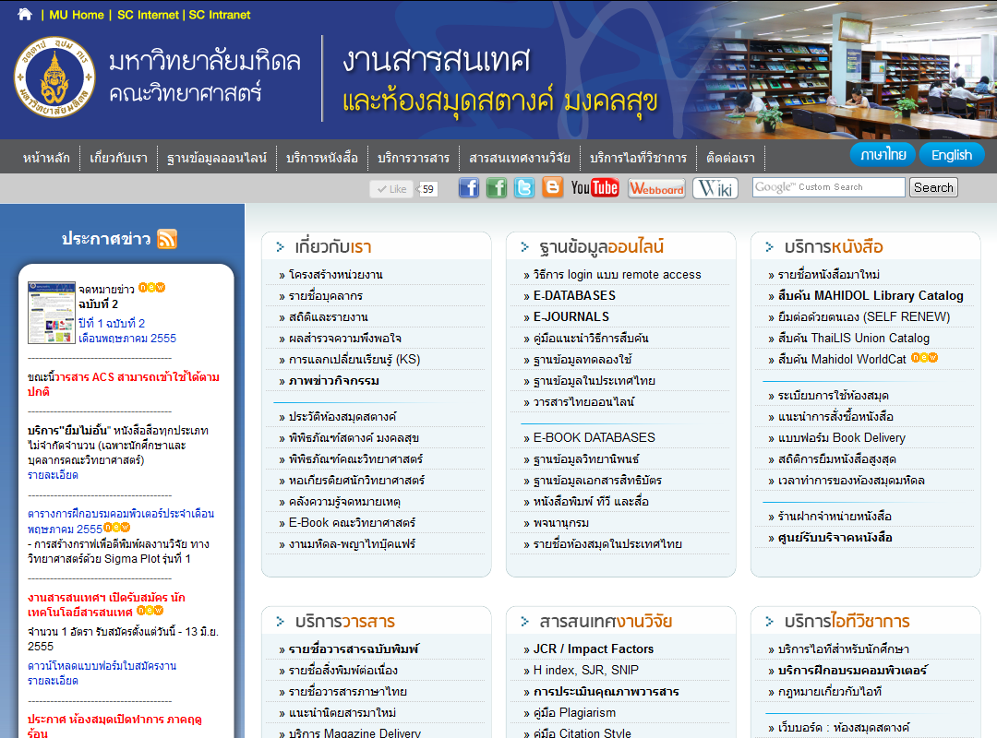
Library Website : stang.sc.mahidol.ac.th

Slide 9
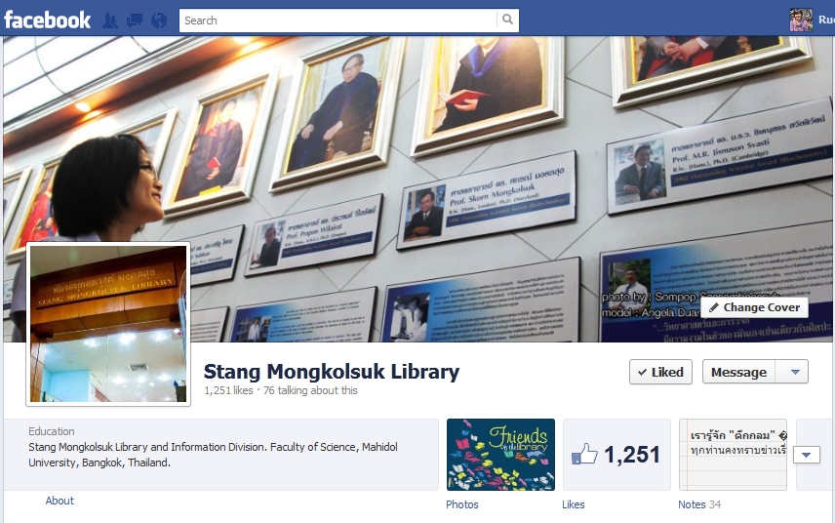
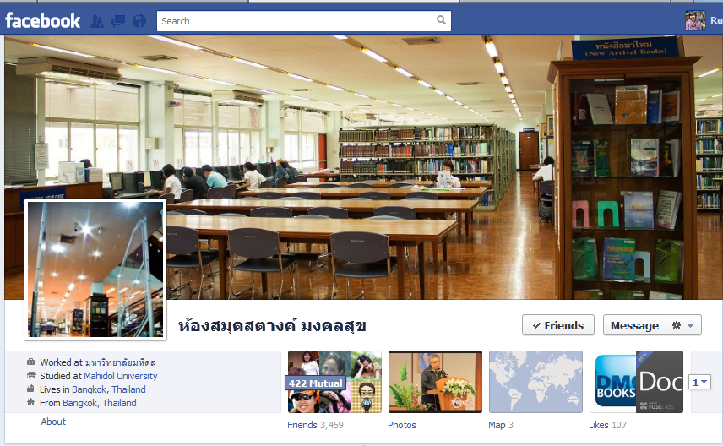
Facebook.com/
StangMongkolsukLibrary
(1,251 Likes)
Facebook.com/StangLibrary
(3,457 friends)

Slide 10
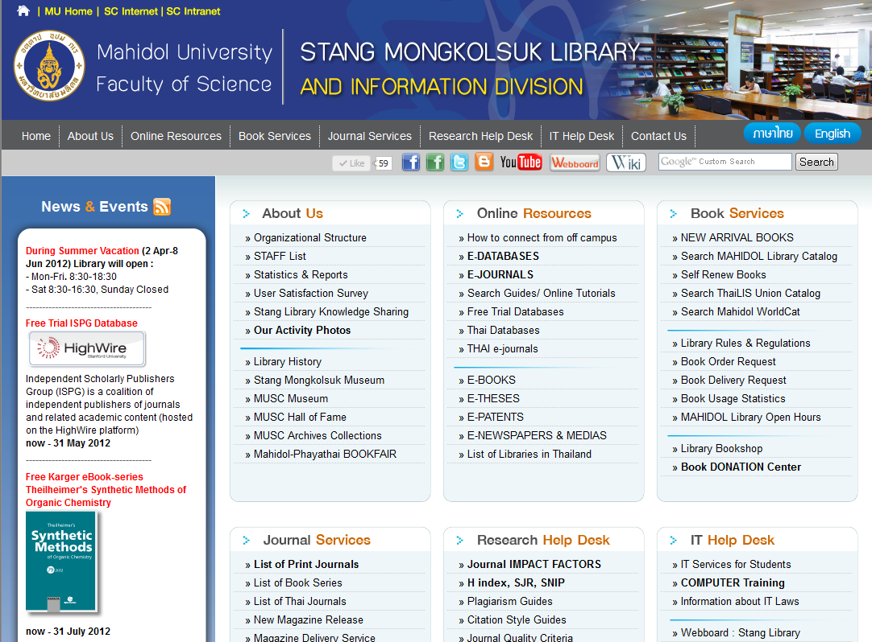
3
1
2
4
5

Slide 11
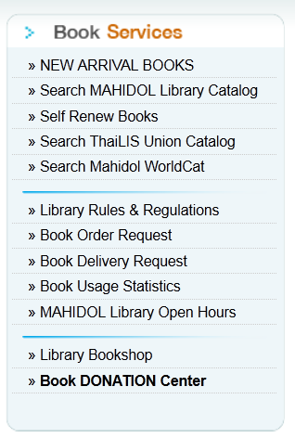
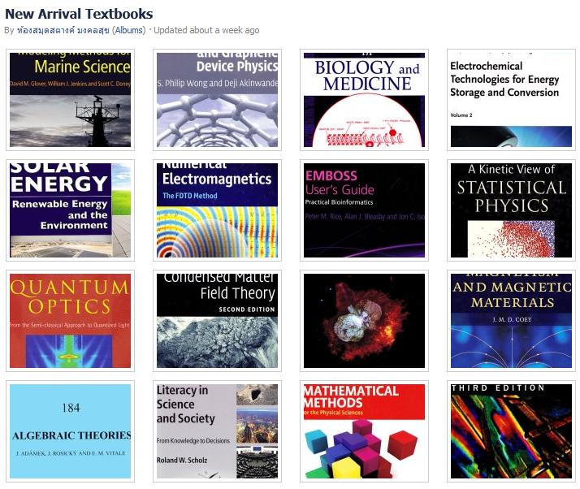
1
1

Slide 12
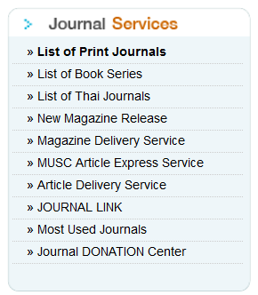
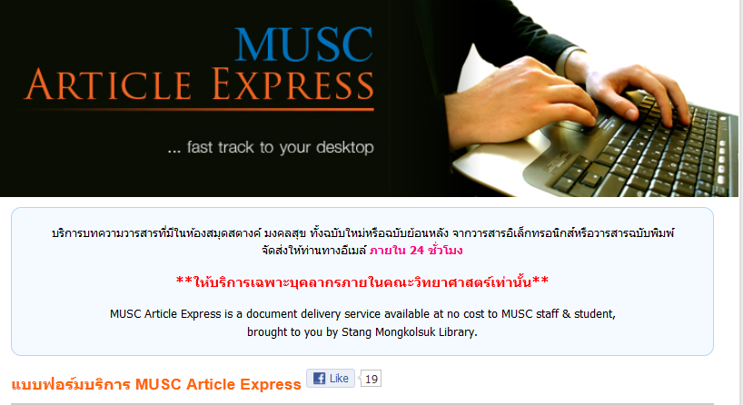

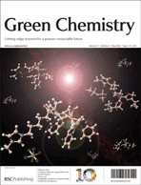

2

Slide 13

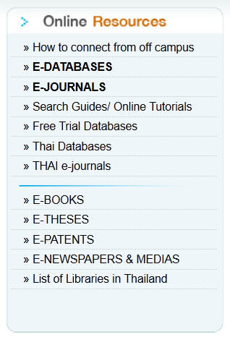




3
Access to
130 e-databases & e-books
7,765 full-text scientific peer-review e-journals
20,000 subscribed & open access e-journals
(all subject categories)

Slide 14
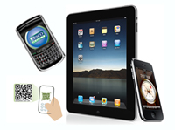
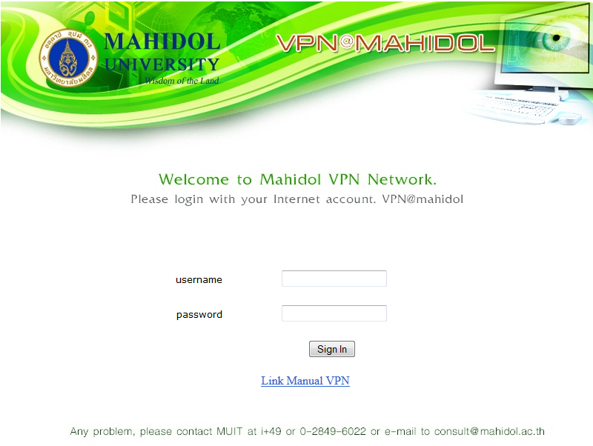




Remote Access from home
http://vpn.mahidol.ac.th

Slide 15
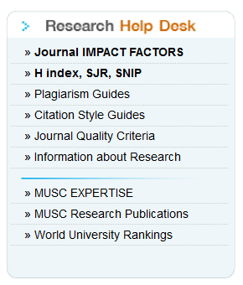
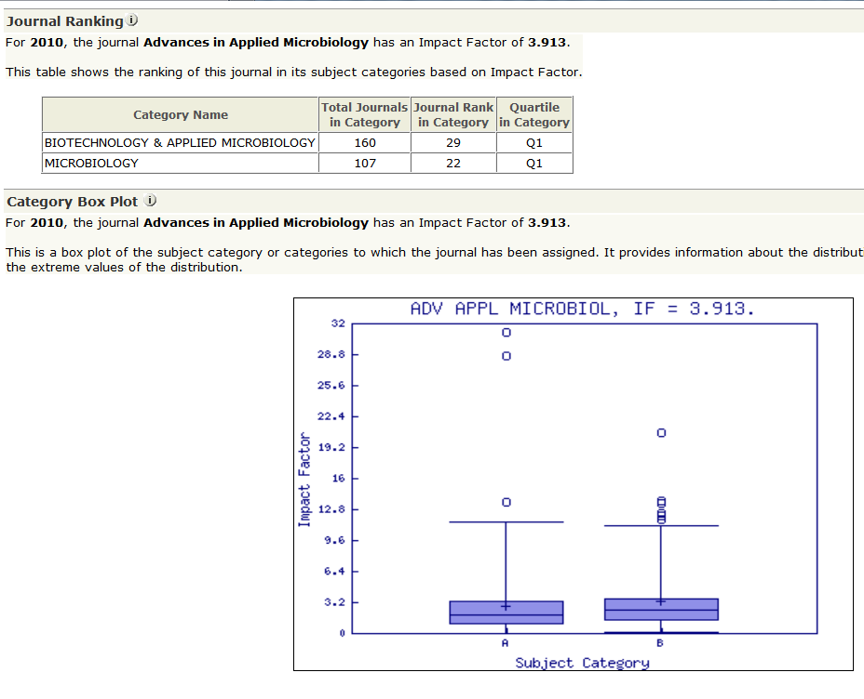
4

Slide 16
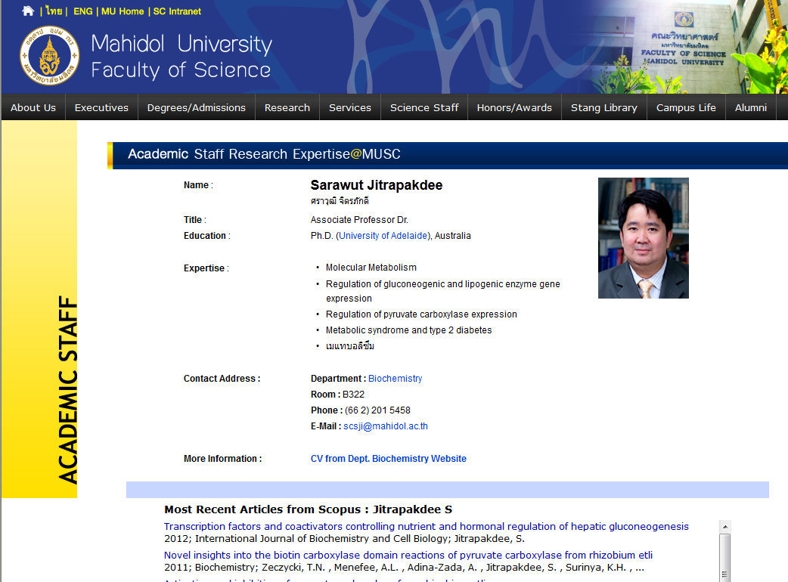
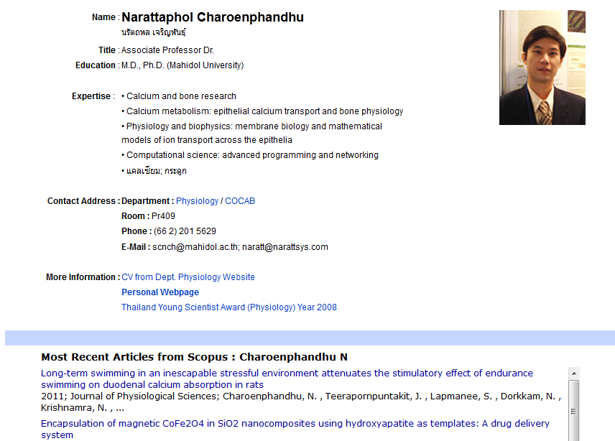

Slide 17
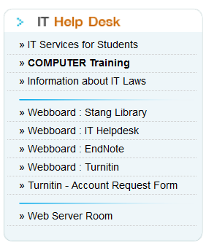
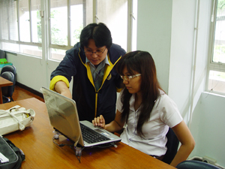
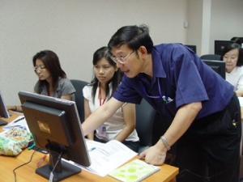
5

Slide 18
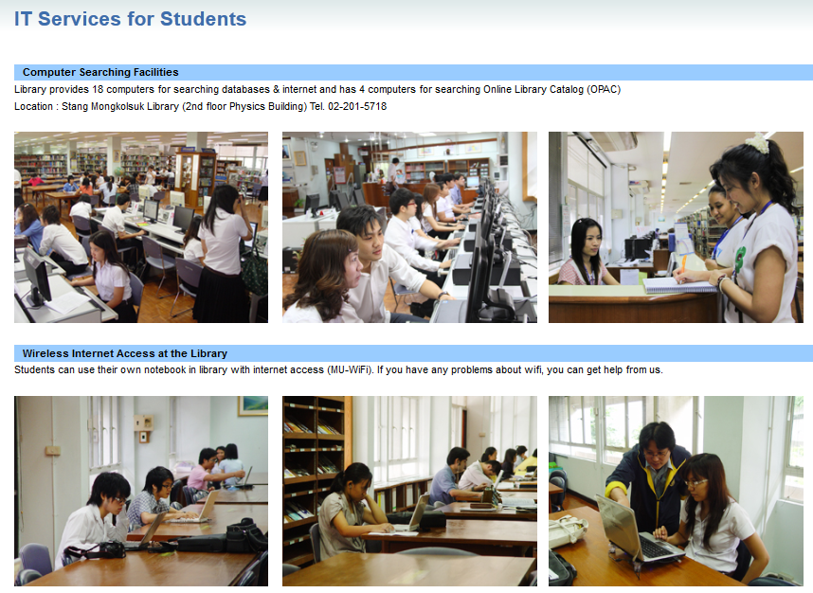

Slide 19
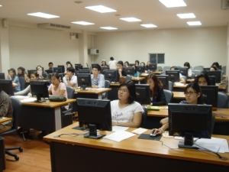
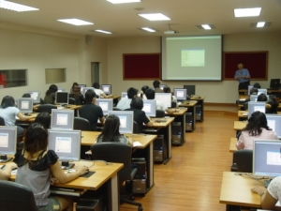
Computer room (for ICT Literacy Training)
EndNote
Turnitin
MS Office
Photoshop
Mendeley
Google Docs
Sigma Plot
Dreamweaver

Slide 20
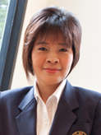

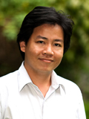
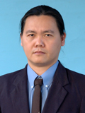

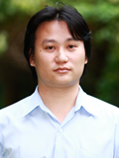




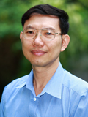

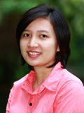


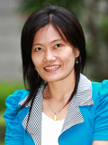
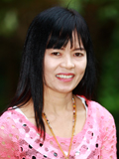
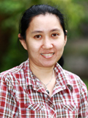
Our staff are always willing to help you, please feel free to ask.
THANK YOU FOR YOUR PATRONAGE

